Slide 1
3.10.2020
Magenic Masters Live – Intro To Machine Learning
Kevin Ford
kevinf@magenic.com
617 359-5192

Slide 2
https://github.com/Magenic/MMLIntroToML

Slide 3
What does IBM Watson offer?
Assistant
Studio
Compare and Comply
Discovery
Speech to Text
Text to Speech
Natural Language Classifier
Personality Insights
Tone Analyzer
Watson Studio
Knowledge Studio
Knowledge Catalog

Slide 4
Lab 1: Setting up Watson account
https://cloud.ibm.com/
Create Watson
Add payment information
This may take a few days

Slide 5
Discovery

Slide 6
Discovery
No Particular ML knowledge needed
Custom tagging
Tie to Chatbot
Extarct text from images
Search variety of documents
REST APIs
Data Sources: Watson storage, Box, Salesforce, Microsoft SharePoint Online, IBM Cloud Object Storage, Microsoft SharePoint 2016, web crawl
Document types: PDF, Word, PowerPoint, Excel, PNG**, TIFF**, JPG**, JSON*, HTML*

Slide 7
Demo – Using Discovery
Discovery Location
https://cloud.ibm.com/catalog/services/discovery
Creating service
Adding documents
Accessing API

Slide 8
Personality Insights

Slide 9
Personality Insights
Take almost any type of input
Big Five personality characteristics
Immediate response
Needs
Simple REST API
Values

Slide 10
Demo – Using Personality
Create Service
https://cloud.ibm.com/catalog/services/personality-insights

Slide 11
Watson Studio
Simple custom machine learning
Projects – create models
Easily deploy to REST Service
Limited knowledge of algorithms
Most useful with classification and regression
Tie to Machine Learning Service

Slide 12
Demo – Using Watson Studio
Watson Studio
https://cloud.ibm.com/catalog/services/data-science-experience
Machine Learing
https://cloud.ibm.com/catalog/services/pm-20

Slide 13
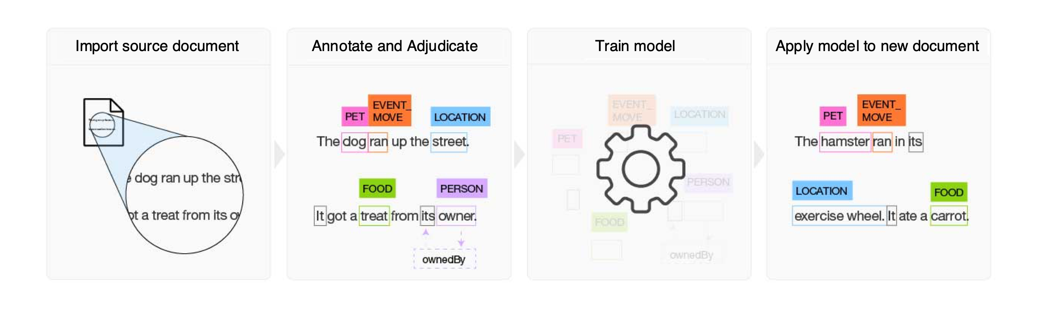
Knowledge Studio

Slide 14
Demo – Knowledge Studio
Create Instance
https://cloud.ibm.com/catalog/services/knowledge-studio
Example Instance
https://us-south.knowledge-studio.watson.cloud.ibm.com/knowledge-studio/tools/app/rzhz11/tnab7i45c3fs6a53/ui/#/

Slide 15
Homework Readings
Readings:
https://cloud.ibm.com/docs/natural-language-classifier?topic=natural-language-classifier-natural-language-classifier#natural-language-classifier
https://cloud.ibm.com/docs/natural-language-classifier?topic=natural-language-classifier-about
https://cloud.ibm.com/docs/natural-language-classifier?topic=natural-language-classifier-best-practices-overview
https://cloud.ibm.com/docs/natural-language-classifier?topic=natural-language-classifier-using-your-data
https://cloud.ibm.com/apidocs/natural-language-classifier

Slide 16
Homework project
Create a Natural Language Classifier Service
Create the same model you created in week 2 in Azure
Which is more accurate?

Slide 17
Q & A

